Slide 1

Chapter 5: Project Scope Management
Information Technology Project Management, Seventh Edition

Slide 2
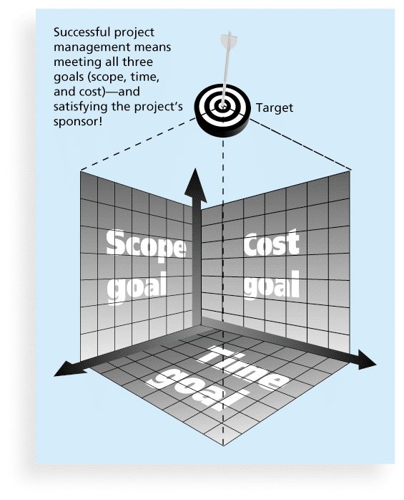
What Is a Project?
A project is “a temporary endeavor undertaken to create a unique product, service, or result” (PMBOK® Guide, 5th Edition, 2012)
Project management is “the application of knowledge, skills, tools and techniques to project activities to meet project requirements” (PMBOK® Guide, 5th Edition, 2012)
Triple Constraint of Project Management

Slide 3
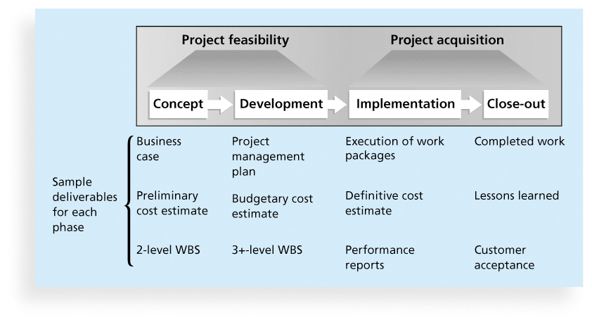
Phases of the Traditional Project Life Cycle

Slide 4
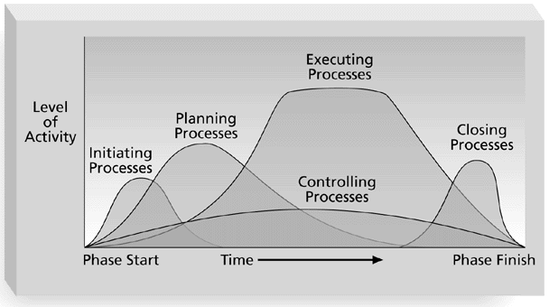
Overlap of Process Groups

Slide 5
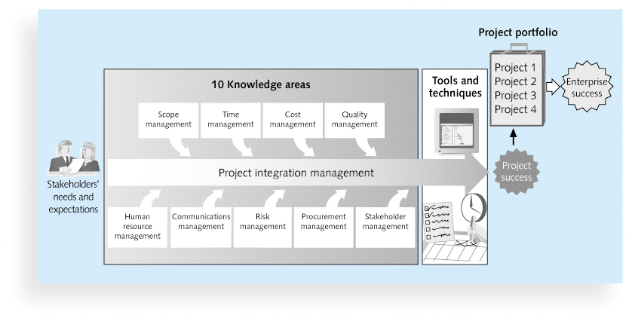
Project Management Framework

Slide 6
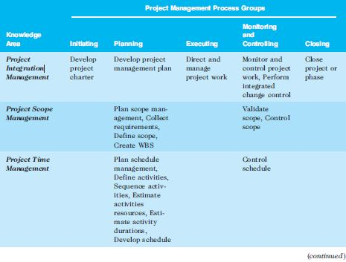
Project Management Process Groups and Knowledge Area Mapping (PMBOK®, 5th ed., 2012)
Information Technology Project Management, Seventh Edition

Slide 7
Learning Objectives
Understand the importance of good project scope management
Describe the process of planning scope management
Discuss methods for collecting and documenting requirements to meet stakeholder needs and expectations
Explain the scope definition process and describe the contents of a project scope statement
Discuss the process for creating a work breakdown structure using the analogy, top-down, bottom-up, and mind-mapping approaches
Explain the importance of validating scope and how it relates to defining and controlling scope
Understand the importance of controlling scope and approaches for preventing scope-related problems on information technology (IT) projects

Slide 8
What is Project Scope Management?
Scope refers to all the work involved in creating the products of the project and the processes used to create them
A deliverable is a product produced as part of a project, such as hardware or software, planning documents, or meeting minutes
Project scope management includes the processes involved in defining and controlling what is or is not included in a project

Slide 9
Project Scope Management Processes
Planning scope: determining how the project’s scope and requirements will be managed
Collecting requirements: defining and documenting the features &functions of the products produced during the project as well as the processes used for creating them
Defining scope: reviewing the project charter, requirements documents, and organizational process assets to create a scope statement
Creating the WBS: subdividing the major project deliverables into smaller, more manageable components
Validating scope: formalizing acceptance of the project deliverables
Controlling scope: controlling changes to project scope throughout the life of the project

Slide 10
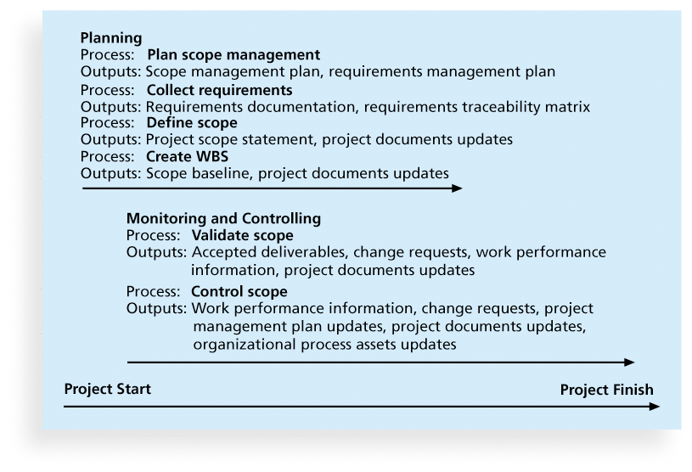
Project Scope Management Summary

Slide 11
Learning Objectives
Understand the importance of good project scope management
Describe the process of planning scope management
Discuss methods for collecting and documenting requirements to meet stakeholder needs and expectations
Explain the scope definition process and describe the contents of a project scope statement
Discuss the process for creating a work breakdown structure using the analogy, top-down, bottom-up, and mind-mapping approaches
Explain the importance of validating scope and how it relates to defining and controlling scope
Understand the importance of controlling scope and approaches for preventing scope-related problems on information technology (IT) projects

Slide 12
Planning Scope Management
The project team uses expert judgment and meetings to develop two important outputs: the scope management plan and the requirements management plan
The scope management plan is a subsidiary part of the project management plan

Slide 13
Scope Management Plan Contents
How to prepare a detailed project scope statement
How to create, maintain and approve the WBS
How to obtain formal acceptance of the completed project deliverables
How to control requests for changes to the project scope

Slide 14
Learning Objectives
Understand the importance of good project scope management
Describe the process of planning scope management
Discuss methods for collecting and documenting requirements to meet stakeholder needs and expectations
Explain the scope definition process and describe the contents of a project scope statement
Discuss the process for creating a work breakdown structure using the analogy, top-down, bottom-up, and mind-mapping approaches
Explain the importance of validating scope and how it relates to defining and controlling scope
Understand the importance of controlling scope and approaches for preventing scope-related problems on information technology (IT) projects

Slide 15
Requirements Management Plan
Requirements: “conditions or capabilities that must be met by the project or present in the product, service, or result to satisfy an agreement or other formally imposed specification” (PMBOK® Guide, 5th Edition)
The requirements management plan documents how project requirements will be analyzed, documented, and managed

Slide 16
Collecting Requirements
For some IT projects, it is helpful to divide requirements development into categories called elicitation, analysis, specification, and validation
It is important to use an iterative approach to defining requirements since they are often unclear early in a project

Slide 17
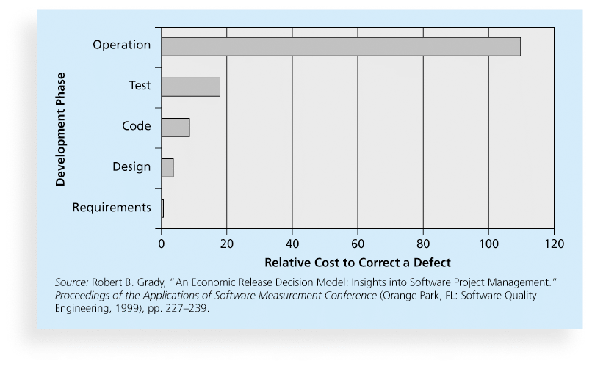
Relative Cost to Correct a Software Requirement Defect

Slide 18
Methods for Collecting Requirements
Interviewing
Focus groups and facilitated workshops
Using group creativity & decision-making techniques
Questionnaires and surveys
Observation
Prototyping
Benchmarking
i.e. generating ideas by comparing specific project practices or product characteristics to those of other projects or products inside or outside the performing organization

Slide 19
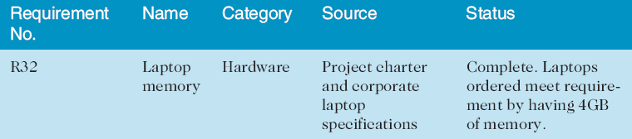
Requirements Traceability Matrix
A requirements traceability matrix (RTM) is a table that lists requirements, various attributes of each requirement, and the status of the requirements to ensure that all requirements are addressed (see sample below)

Slide 20
Learning Objectives
Understand the importance of good project scope management
Describe the process of planning scope management
Discuss methods for collecting and documenting requirements to meet stakeholder needs and expectations
Explain the scope definition process and describe the contents of a project scope statement
Discuss the process for creating a work breakdown structure using the analogy, top-down, bottom-up, and mind-mapping approaches
Explain the importance of validating scope and how it relates to defining and controlling scope
Understand the importance of controlling scope and approaches for preventing scope-related problems on information technology (IT) projects

Slide 21
Defining Scope
Project scope statements should include
product scope description
product user acceptance criteria
detailed information on all project deliverables
other scope-related information: e.g. project boundaries, constraints, and assumptions.
The project scope statement should also reference supporting documents, such as product specifications
As time progresses, the scope of a project should become more clear and specific

Slide 22
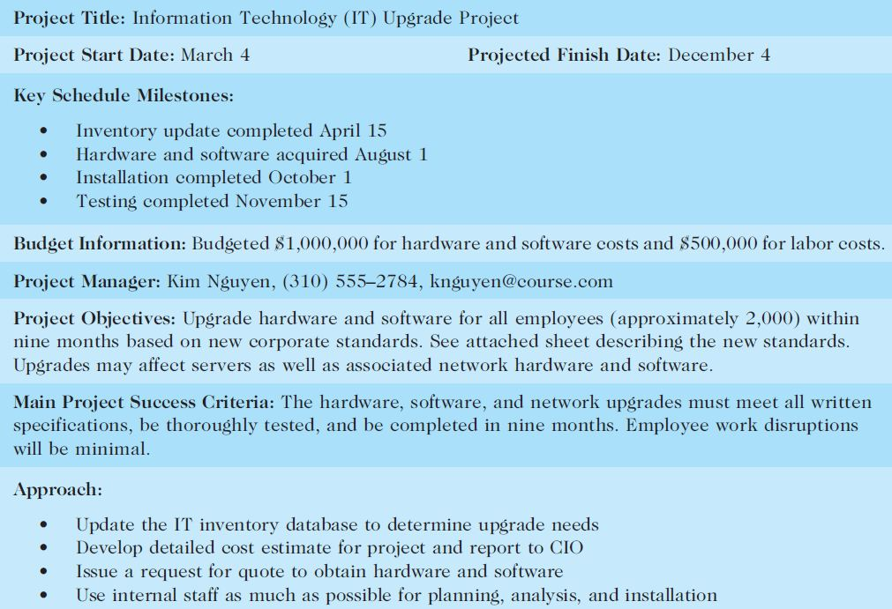
Sample Project Charter (partial)

Slide 23
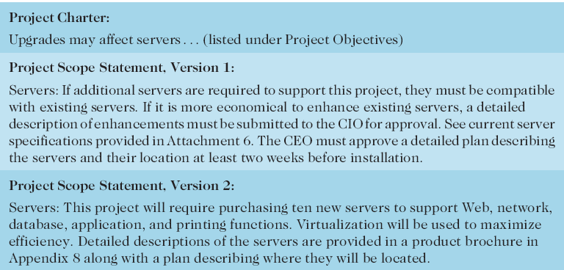
Further Defining Project Scope

Slide 24
Learning Objectives
Understand the importance of good project scope management
Describe the process of planning scope management
Discuss methods for collecting and documenting requirements to meet stakeholder needs and expectations
Explain the scope definition process and describe the contents of a project scope statement
Discuss the process for creating a work breakdown structure using the analogy, top-down, bottom-up, and mind-mapping approaches
Explain the importance of validating scope and how it relates to defining and controlling scope
Understand the importance of controlling scope and approaches for preventing scope-related problems on information technology (IT) projects

Slide 25
Work Breakdown Structure (WBS)
After completing scope planning, the next step is to further define the work by breaking it into manageable pieces
WBS is a deliverable-oriented grouping of the work involved in a project that defines the total scope of the project
It is a foundation document for planning and managing project schedules, costs, resources, and changes – i.e. for all communication about work responsibilities

Slide 26
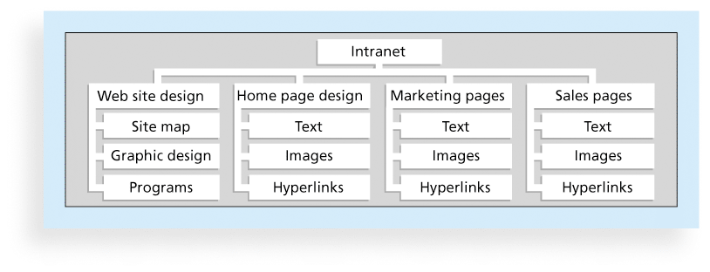
Sample Intranet WBS → Organized by Product

Slide 27
Creating the Work Breakdown Structure (WBS)
Decomposition is subdividing project deliverables into smaller pieces
A work package is a task at the lowest* level of the WBS
* naming of task levels can vary!!

Slide 28
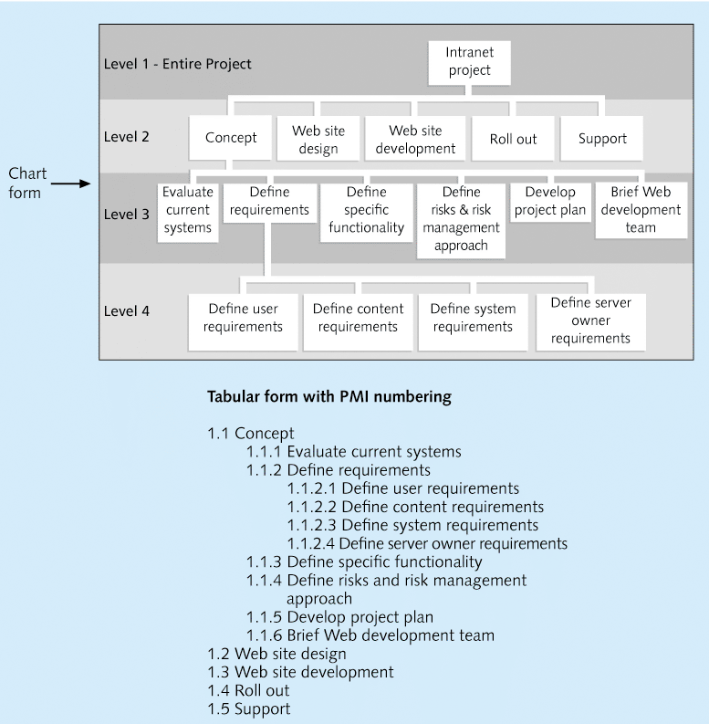
Sample Intranet WBS → Organized by Phase
Summary task
Work Package

Slide 29
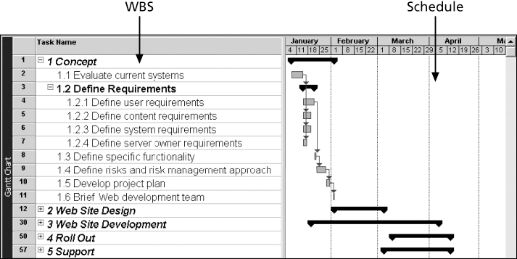
Intranet WBS and Gantt Chart in MS Project

Slide 30
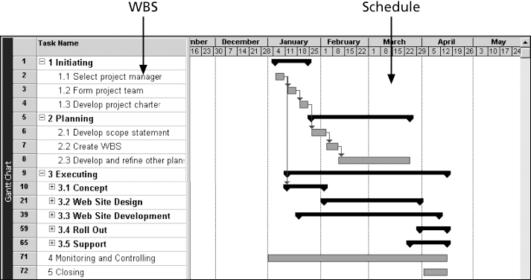
Intranet Gantt Chart Organized by Project Management Process Groups

Slide 31
Approaches to Developing WBSs
Using guidelines: Some organizations provide guidelines for preparing WBSs
The analogy approach: Review WBSs of similar projects and tailor to your project
The top-down approach: Start with the largest items of the project and break them down
The bottom-up approach: Start with the specific tasks and roll them up
Mind-mapping approach: is a technique that uses branches radiating out from a core idea to structure thoughts and ideas

Slide 32
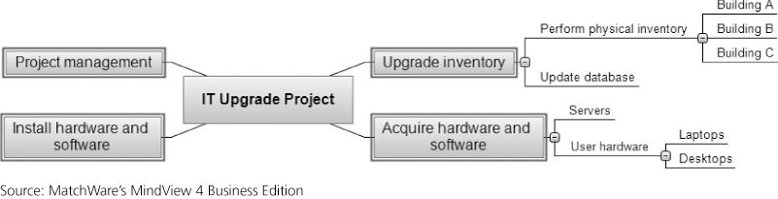
Sample Mind-Mapping Approach for Creating a WBS

Slide 33
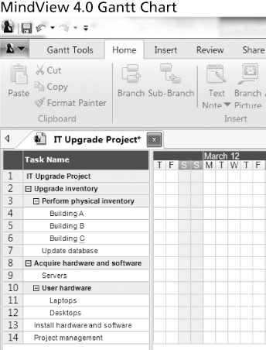
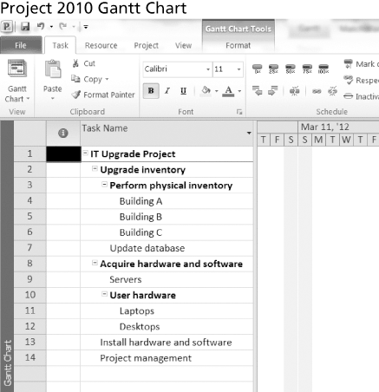
Gantt Charts With WBS Generated From a Mind Map

Slide 34
WBS Dictionary and Scope Baseline
Many WBS tasks are vague and must be explained more so people know what to do and can estimate how long it will take and what it will cost to do the work
A WBS dictionary is a document that describes detailed information about each WBS item
The scope baseline includes the approved project scope statement and its associated WBS and WBS dictionary

Slide 35
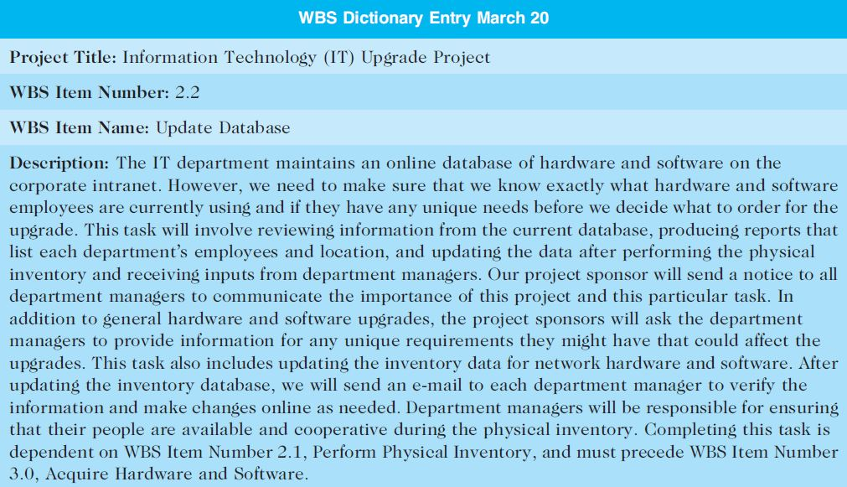
Sample WBS Dictionary Entry

Slide 36
Advice for Creating a WBS and WBS Dictionary
A unit of work should appear at only one place in the WBS
The work content of a WBS item is the sum of the WBS items below it
A WBS item is the responsibility of only one individual, even though many people may be working on it
The WBS must be consistent with the way in which work is actually going to be performed; it should serve the project team first (other purposes only if practical)

Slide 37
Advice for Creating a WBS and WBS Dictionary (cont’d)
Project team members should be involved in developing the WBS to ensure consistency and buy-in
Each WBS item must be documented in a WBS dictionary to ensure accurate understanding of the scope of work included and not included in that item
WBS must be a flexible tool to accommodate inevitable changes while properly maintaining control of the work content in the project according to the scope statement

Slide 38
Learning Objectives
Understand the importance of good project scope management
Describe the process of planning scope management
Discuss methods for collecting and documenting requirements to meet stakeholder needs and expectations
Explain the scope definition process and describe the contents of a project scope statement
Discuss the process for creating a work breakdown structure using the analogy, top-down, bottom-up, and mind-mapping approaches
Explain the importance of validating scope and how it relates to defining and controlling scope
Understand the importance of controlling scope and approaches for preventing scope-related problems on information technology (IT) projects

Slide 39
Validating Scope
It is very difficult to create a good scope statement and WBS for a project
It is even more difficult to verify project scope and minimize scope changes
Scope validation involves formal acceptance of the completed project deliverables
Acceptance is often achieved by a customer inspection and then sign-off on key deliverables

Slide 40
Learning Objectives
Understand the importance of good project scope management
Describe the process of planning scope management
Discuss methods for collecting and documenting requirements to meet stakeholder needs and expectations
Explain the scope definition process and describe the contents of a project scope statement
Discuss the process for creating a work breakdown structure using the analogy, top-down, bottom-up, and mind-mapping approaches
Explain the importance of validating scope and how it relates to defining and controlling scope
Understand the importance of controlling scope and approaches for preventing scope-related problems on information technology (IT) projects

Slide 41
Controlling Scope
Scope control involves controlling changes to the project scope
Goals of scope control are to
influence the factors that cause scope changes
assure changes are processed according to procedures developed as part of integrated change control, and
manage changes when they occur
Variance is the difference between planned and actual performance

Slide 42
What Went Wrong?
A project scope that is too broad and grandiose can cause severe problems
E.g. in 2001, McDonald’s fast-food chain initiated a project to create an intranet that would connect its headquarters with all of its restaurants to provide detailed operational information in real time. After spending $170 million on consultants and initial implementation planning, McDonald’s realized that the project was too much to handle and terminated it

Slide 43
Best Practices for Avoiding Scope Problems
Keep the scope realistic. Don’t make projects so large that they can’t be completed. Break large projects down into a series of smaller ones
Involve users in project scope management. Assign key users to the project team and give them ownership of requirements definition and scope verification
Use off-the-shelf hardware & software whenever possible. Many IT people enjoy using the latest and greatest technology, but business needs, not technology trends, must take priority
Follow good project management processes

Slide 44
Suggestions for Improving User Input
Develop a good project selection process and insist that sponsors are from the user organization
Have users on the project team in important roles
Have regular meetings with defined agendas, and have users sign off on key deliverables presented at meetings
Deliver something to users and sponsors on a regular basis
Don’t promise to deliver when you know you can’t
Co-locate users with developers

Slide 45
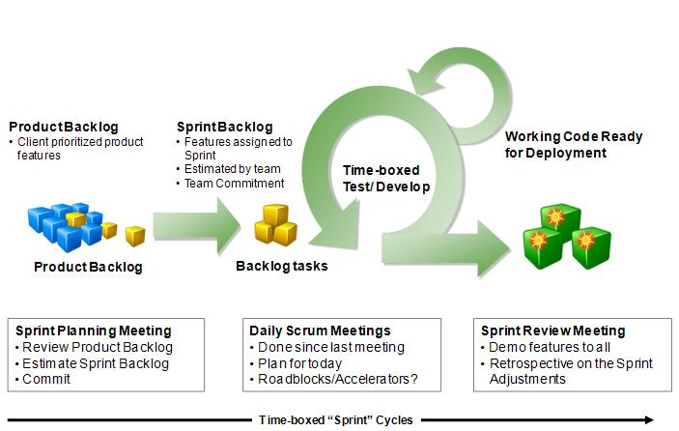
Scrum Framework
Scrum Methodology

Slide 46
Suggestions for Reducing Incomplete and Changing Requirements
Develop and follow a requirements management process
Use techniques such as prototyping, Use case modeling, and Joint Application Design (JAD) to get more user involvement
Put requirements in writing and keep them current
Create a requirements management database for documenting and controlling requirements

Slide 47
Suggestions for Reducing Incomplete and Changing Requirements (cont’d)
Provide adequate testing and conduct testing throughout the project life cycle
Review changes from a systems perspective
Emphasize completion dates to help focus on what’s most important
Allocate resources specifically for handling change requests/enhancements

Slide 48
Chapter Summary
Project scope management includes the processes required to ensure that the project addresses all the work required, and only the work required, to complete the project successfully
Main processes include
Define scope management
Collect requirements
Define scope
Create WBS
Validate scope
Control scope

